Slide 1

Secant Method
Prianka Mandal
Lecturer
Daffodil International University

Slide 2

Introduction
The Newton-Raphson method of solving a nonlinear equation f(x)=0 is given by the iterative formula.
...................(1)
One of the drawback of this formula is derivative of the function could be zero, causing result in error.
To solve this problem, the 1st derivative of a function is replaced with Backward divided difference formula.
This method is called the Secant method.

Slide 3


Derivation of secant method
According to Backward divided difference formula, 1st derivative of a function can be written as:
.........(2)
Substituting Equation (2) in Equation (1) gives (3)
.........(3)
This is the formula for Secant method.

Slide 4
Secant method
This method needs two initial guesses to continue calculation.
Initial guesses are x_{i-1} and x_{i}
We have to calculate x_{i+1} for finding root of the function.

Slide 5
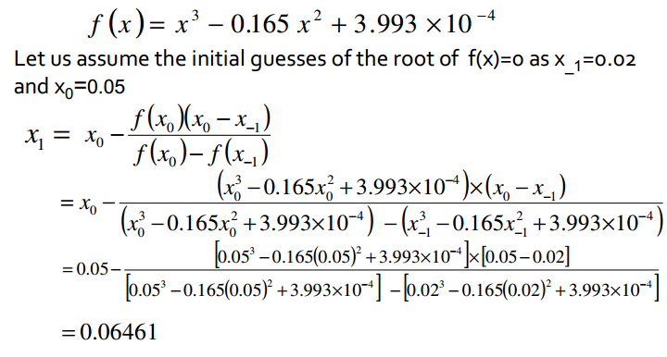
Example

Slide 6



Example (Cont..)
The absolute relative approximate error at the end of Iteration 1 is
As you need an absolute relative approximate error of 5% or less so you need more iteration to carry on.
Iteration 2
The absolute relative approximate error at the end of Iteration 2 is 3.525%

Slide 7
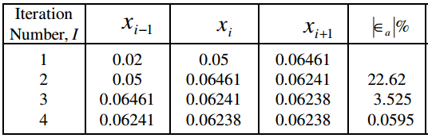
Example (Cont..)
Secant Method Result as Function of Iteration

Slide 8
Thank you!!!

